Slide 1
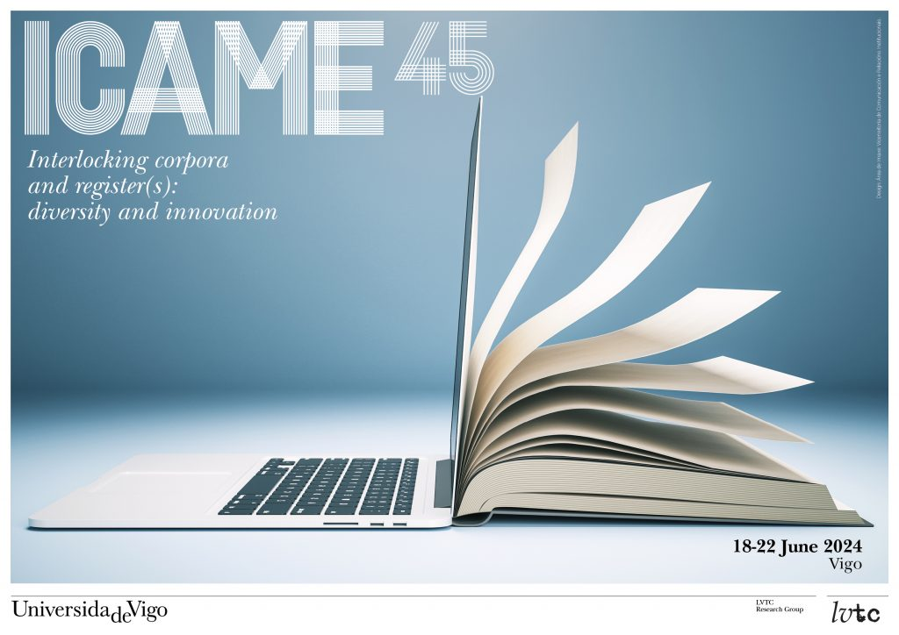
Book Launch Sociopragmatic Variation in Ireland Using pragmatic variation to construct identity DeGruyter (September 2024) Martin Schweinberger and Patricia Ronan (Eds.)

Slide 2
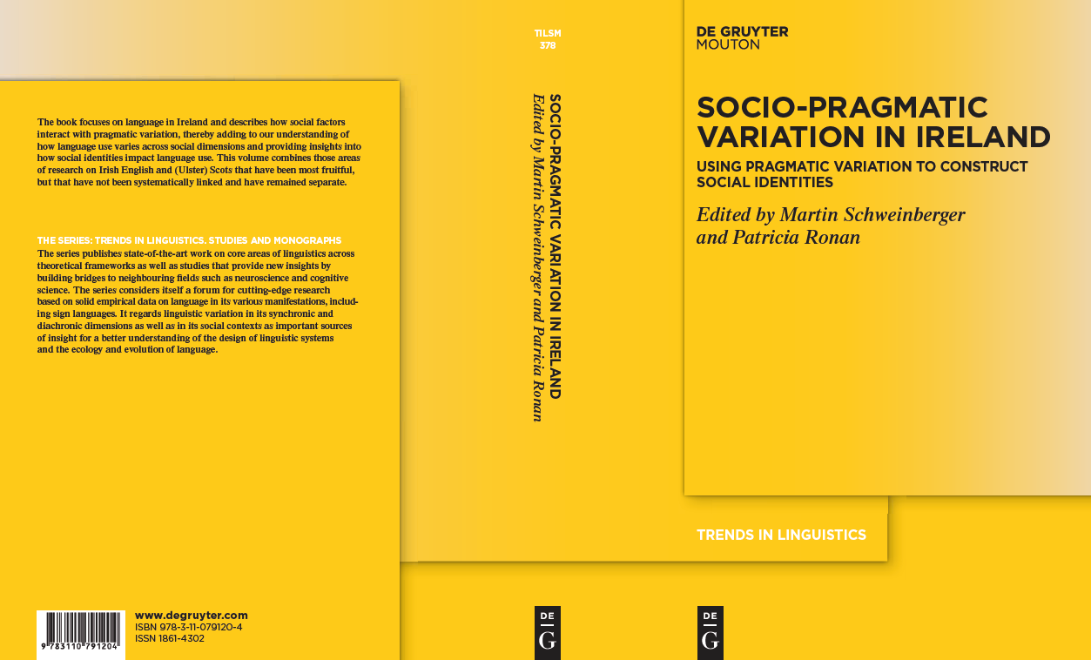
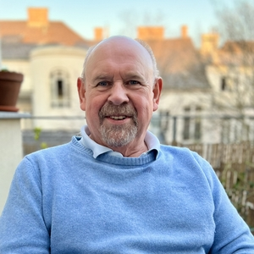
John Kirk is a true first-generation corpus linguist and a founding participant of ICAME. He was born in Falkirk, Scotland, in 1952 and spent the majority of his career at Queen’s University Belfast (1983 to 2013) before becoming Professor at the University of Vienna. He has also been active as a visiting scholar around the world.
John has been instrumental to corpus linguistics through the various corpus resources he has (co-) compiled, such as ICE-Ireland, SPICE-Ireland, the Digital Lexical Atlas of Scotland, or the International Comparable Corpus (ICC).
John stands out as a warm, welcoming, supportive, and incredibly productive member of our community.

Slide 4
